Slide 1
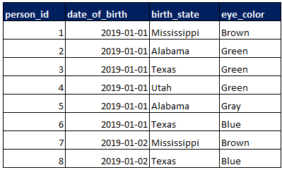
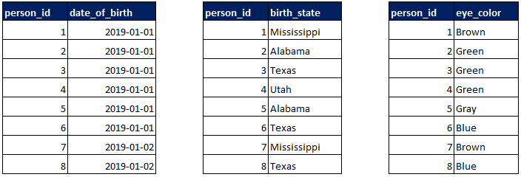
Row store vs column store
Row Store
Column Store
Notes:
“In a row-oriented indexed system, the primary key is the rowid that is mapped from indexed data. In the column-oriented system, the primary key is the data, which is mapped from rowids.”
“ That said, online transaction processing (OLTP)-focused RDBMS systems are more row-oriented, while online analytical processing (OLAP)-focused systems are a balance of row-oriented and column-oriented.”

Slide 2
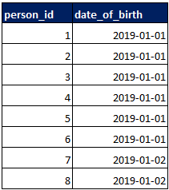

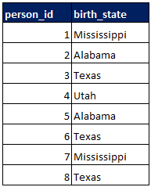
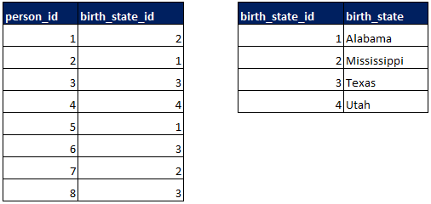
Column store compression
Run Length Compression
Dictionary Compression

Slide 3
More about data compression
Why dictionary compression works
SELECT DATALENGTH('Utah'); -- 4
SELECT DATALENGTH('Alabama'); -- 7
SELECT DATALENGTH(CAST('Alabama' AS NVARCHAR)); --14
SELECT DATALENGTH(CAST(1 AS TINYINT)); -- 1
SELECT DATALENGTH(CAST(255 AS TINYINT)); -- 1
Other compression types
Cluster Encoding, Sparse Encoding, Delta Encoding, Etc.
Cardinality and compression
High Cardinality = Most values in the column are unique.
Low Cardinality = The column contains a few distinct values.
In general, low cardinality columns will allow for a higher compression rate.
Column store + compression allows for in-memory and massively parallel processing

Slide 4
Where is column store used?
Relational Database Management Systems (RDBMS)
SQL Server Columnstore Indexes
SAP HANA
Enterprise Data Warehouse (EDW)
Amazon Redshift
Azure SQL Data Warehouse
Snowflake
Google BigQuery
Apache Hadoop
Parquet
ORC
Kudu
Online Analytical Processing (OLAP)
Analysis Services Tabular Models
Data Visualization Tools
Power BI Import (xVelocity in-memory analytics engine)
Tableau Data Extracts/Hyper

Slide 5
EXTRACT, TRANSFORM, LOAD
Snowflake’s performance, ability to handle semi-structured types, and distinct storage and compute make it distinctly suitable for following an ELT pattern.
This means that virtually all of your data work can be handled on the database engine using SQL.
A wide range of data integration tools support Snowflake.
Any tool that supports connections via ODBC/JDBC can be used.

